Slide 1
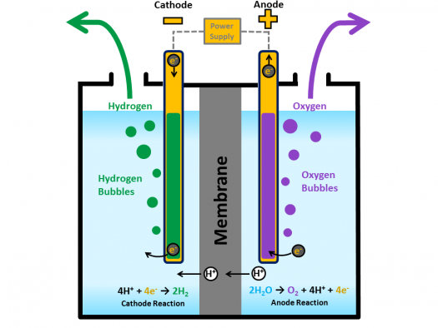
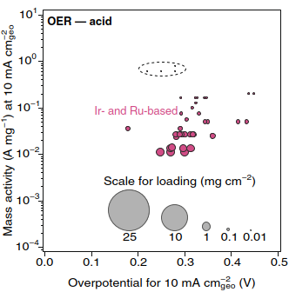

OER Catalysts for Acidic Media
Historically, only Ru and Ir-based catalysts have exhibited acid-stability
High Cost
Low availability
Major need to explore non-noble metal acid stable catalysts that exhibit high catalytic activity
PEM Electrolyzer
Low pH environment (pH ~0-2)
Poor stability of many catalyst materials
Kibsgaard, J., et. al. Nat Energy 2019.

Slide 2
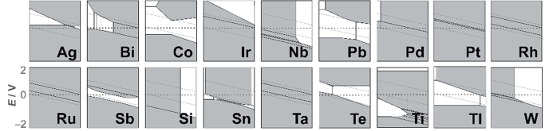
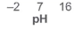
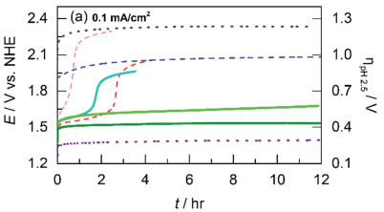
OER Catalysts for Acid-Stable Systems – Gen 1 MAP
Acid stable OER catalyst design by treating activity and stability as decoupled elements of catalyst design
Eg: Co Mn O_{x} (Huynh et. al. Chem. Sci. 2017.)
Structural Element
Active Metal Center
Exploration of various active & structural mixed metal oxides (M = 1-4)
Synthesis via electrodeposition for large parameter space
MnO_{x}
CoO_{x}
CoMnO_{x}
Reduced Metal Oxides
Metal Alloy Systems
Substrate Effects
Ion Insertion
Future Gen

Slide 3
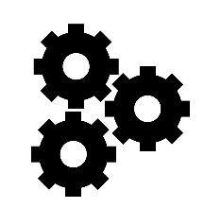
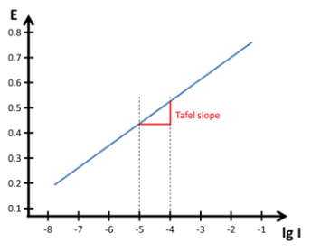
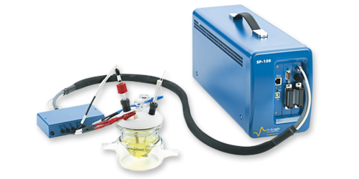
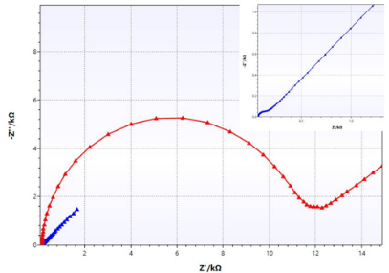
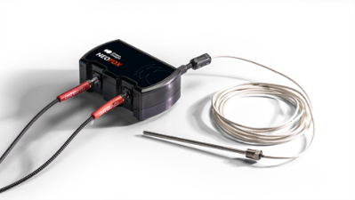
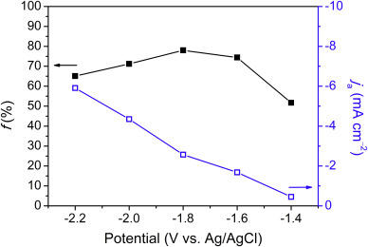
Measurement Parameters – Electrochemical Module
On-Board Electrochemistry
Performance Descriptors
Cyclic Voltammetry
EIS
Linear Sweep Voltammetry
Chronoamperometry
Overpotential (ƞ)
Reaction kinetics
ECSA
Lifetime stability
Charge-transfer resistance
Gas Analyzer
O₂ Reduction (Pt electrode)
Faradaic efficiency

Slide 4
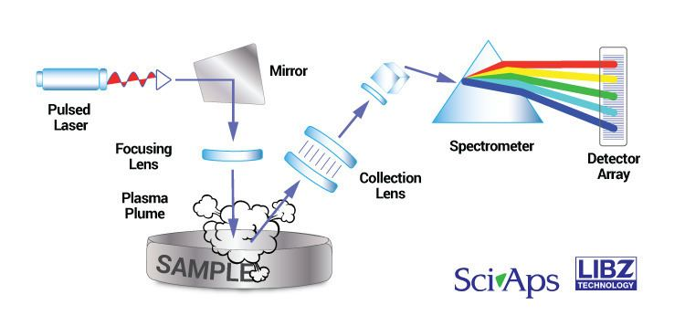
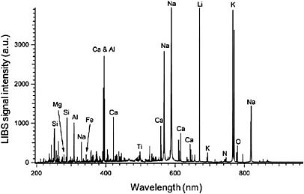
Measurement Parameters – Characterization Module
Elemental Composition
Performance Descriptors
LIBs
XRF
Elemental
Composition
Future Considerations/Expansions
Adapt for Other E-Chem Systems
SAXS
Imaging (Optical/Electron)
Profilometry
QC Balance
Multi-Gas analysis
Calcination
ICP
Scanning Probe E-Chem
Spectroscopy (FTIR etc.)

Slide 5
E-MAP – Conceptual Station Progression
Future Gen
“360⁰” Movement
Ability to program movement across multiple station “visits”
Single robot access to every platform
Calcination
Module
<
Solution
Module
Robot
Characterization
Module
<
Electrochemical
Module

Slide 6

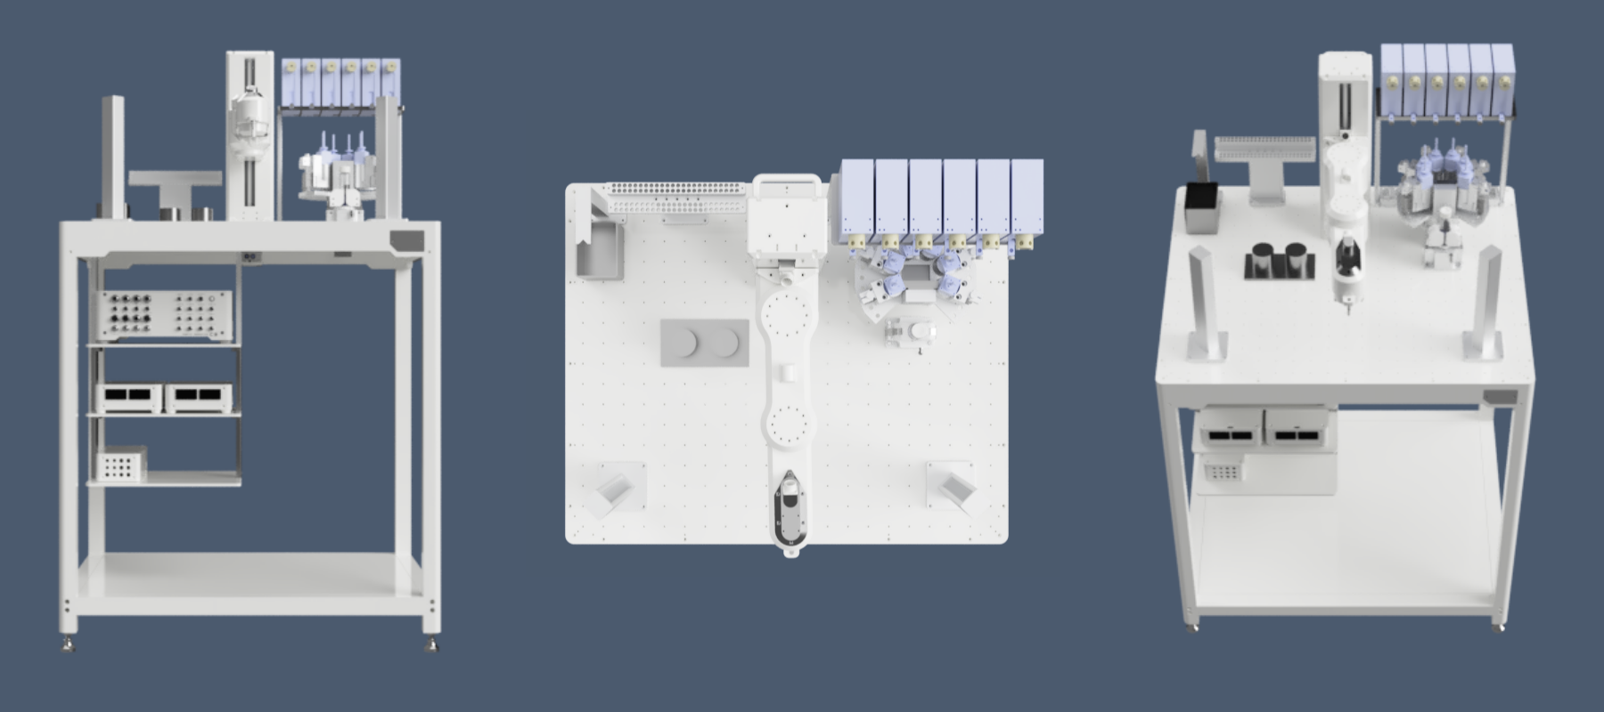
Concept Images – 3D Render (In progress)
Soln Handling
Echem
Char
Not Pictured: E-Chem Module, under design
Not Pictured: Char. Module – “Probe” on board, rest off of platform

Slide 7
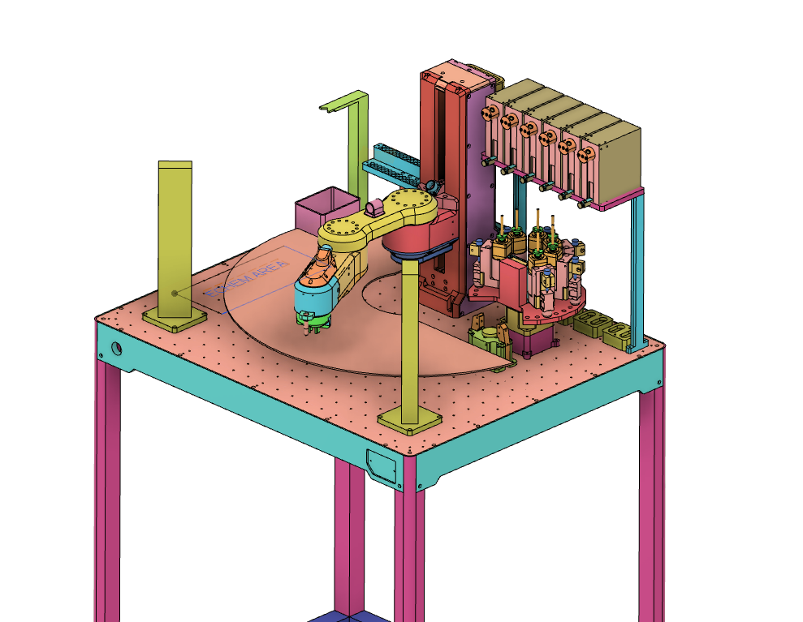
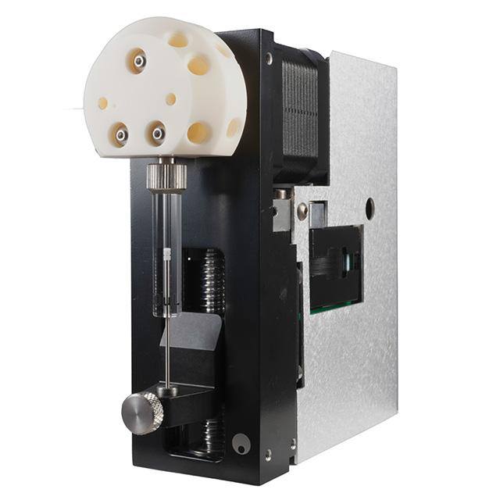
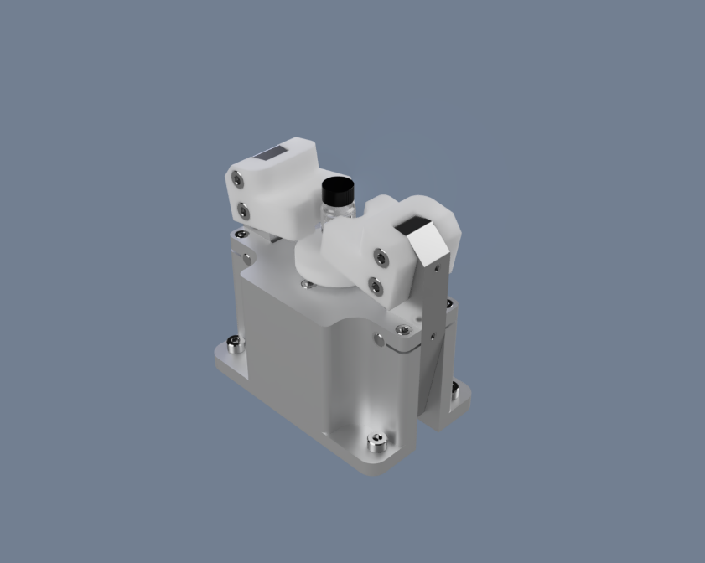
Solution Module – Current Inventory
Modular solution preparation platform that can easily be modified to support various solid/liquid
mixing protocols
1
Liquid Handling (x3)
(Need More?)
2. Solid Dispenser Carousel
(To be Updated?)
3. Gripper + Weigh Scale
4, Slide Hotel (FTO slides)
5. Pipette Station
6. Mixing Plate? (not shown)
5
2
Tecan XC Syringe Pump
6
3
4
Combined gripper + weigh scale

Slide 8
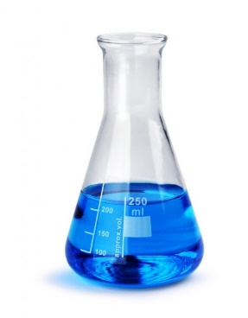
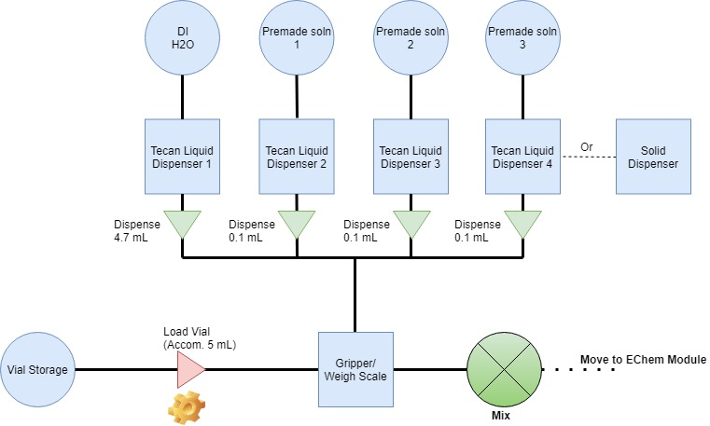
Solution Module – Example Experiment (Ternary Addition)
Solution Preparation
Salt (cation/anion)
Concentration
Deposition Additives
Precursor Order
Gen 1

Slide 9
Solution Module – Input/Outputs + Sizes
Inputs:
Mass/volume salt (precursor sol’n)
Mass/volume solvent
Standard Sizes:
Mixing Vial – Accom. 5 mL
(5 mL will be total mix volume target)
Stock solutions of precursors will be on-board
Target addition range ~100 µL of each
Solvent addition up to 5 mL
If solid addition, range will be in ng - µg range
Outputs:
Deposition Solution

Slide 10
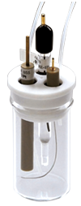
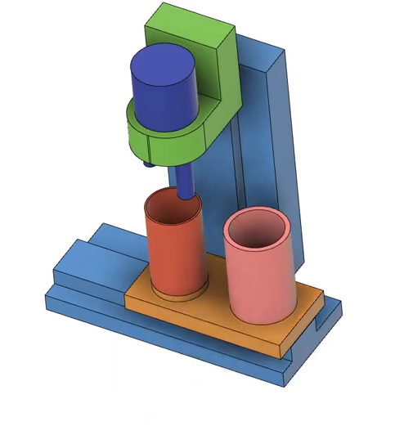
Electrochemistry (Echem) Module – 2x Cells
From benchtop to automated platform
3 electrode cell configuration
Retrieval of WE (FTO slide) for analysis
Electrolyte addition/removal
On-board probe washing
Miniaturization of electrochemical components
Multi-cell scale-up
Benchtop
Concept Drawing

Slide 11
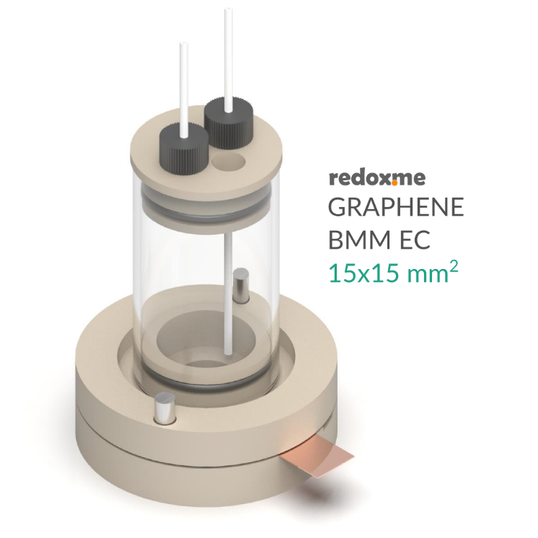
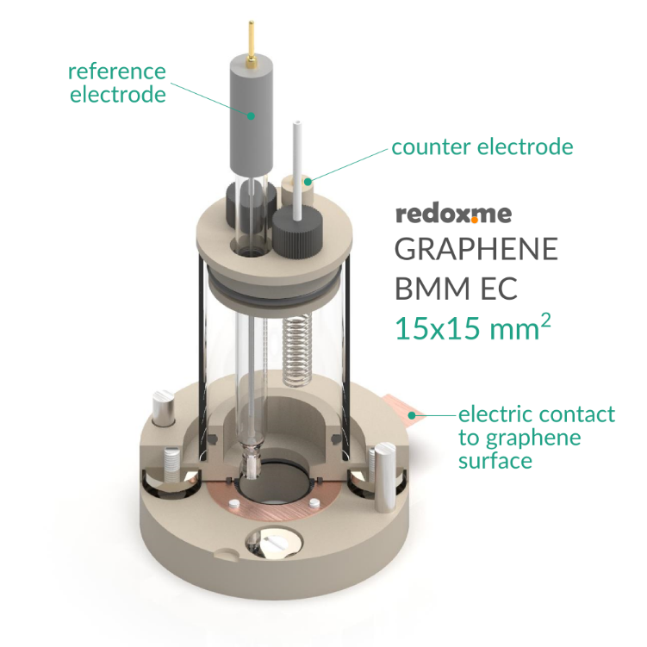
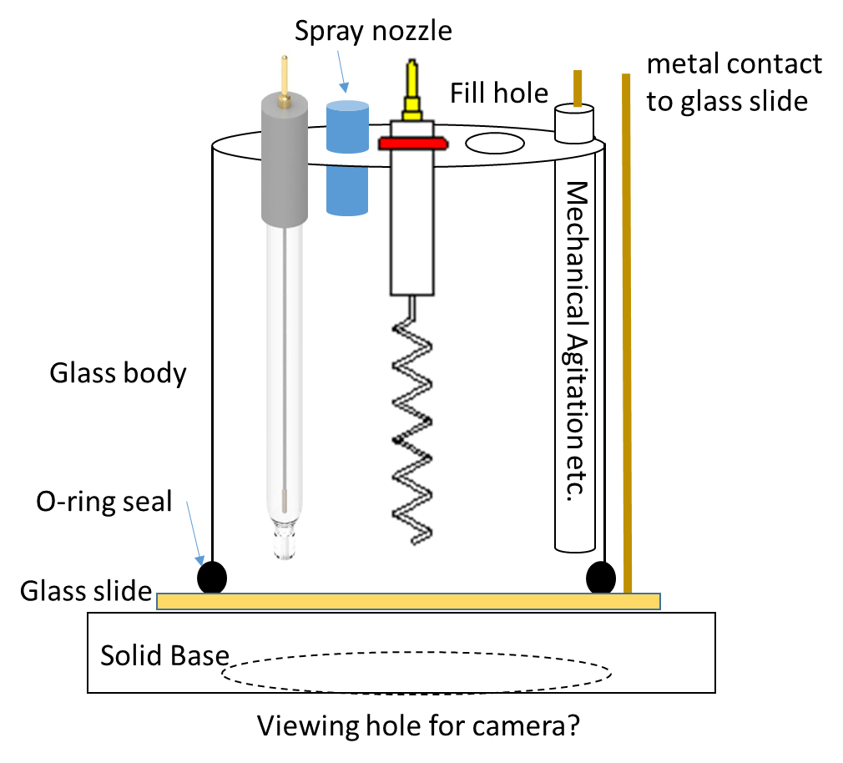

Cell Design
Inspiration from the redox.me bottom-loaded cell
Flexibility while also being able to more easily incorporate robotics/automation
Reconstructed to fit a smaller design space, less electrolyte volume (5 mL total)
https://redox.me/
NRC / North Design

Slide 12
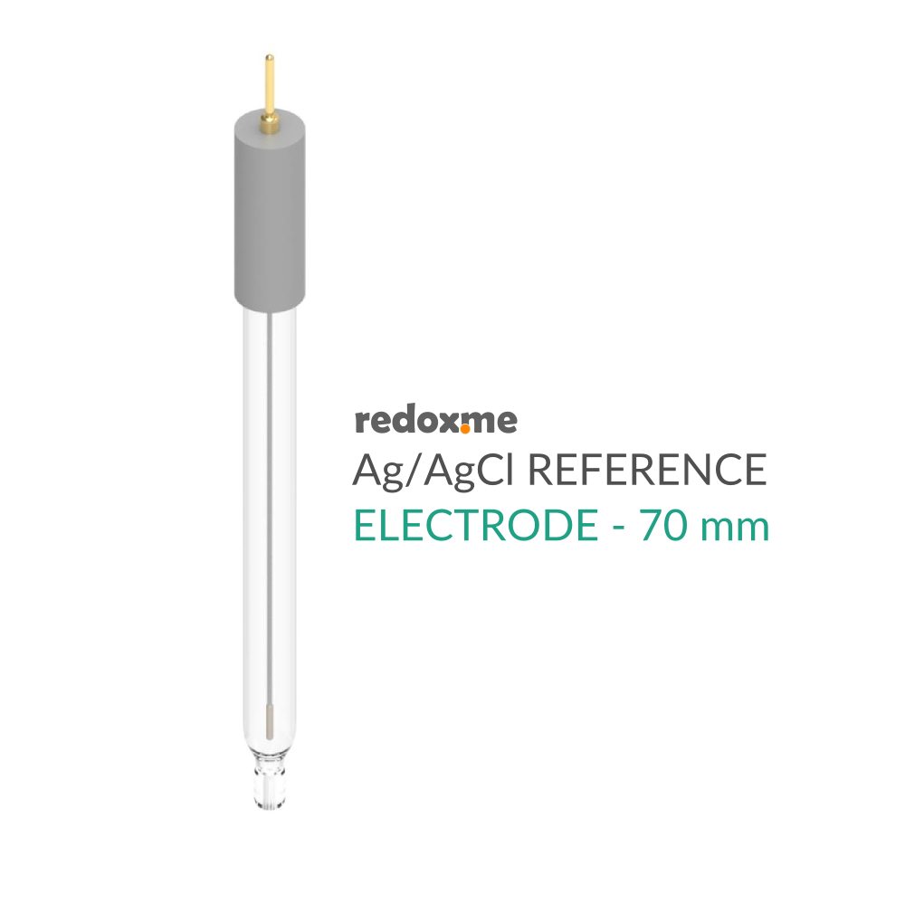
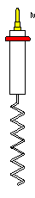
Cell Design – Measurement “Probes” - Outputs
2
3
4
6
Potentiostat Connections
1a. Connection to loaded glass slide (outside of wall)
1b. Loaded glass slide
2. Reference Electrode
3. Counter Electrode
1a
O₂ Analyzer
4. Spectral Probe (will require testing and development)
Camera
5. Through camera?
(MAYBE) Agitation/Propeller?
6. Something to stir solution (bubble remover)
1b
Solid Block
5

Slide 13
Cell Design – Liquid In/Out + Washing
Liquid In/Out
1a. Loading Tube to draw liquid in/out
1b. Some type of pipette system
2
1
Spray (Wash) Nozzle
2. DI water spray to wash probes
Solid Block

Slide 14

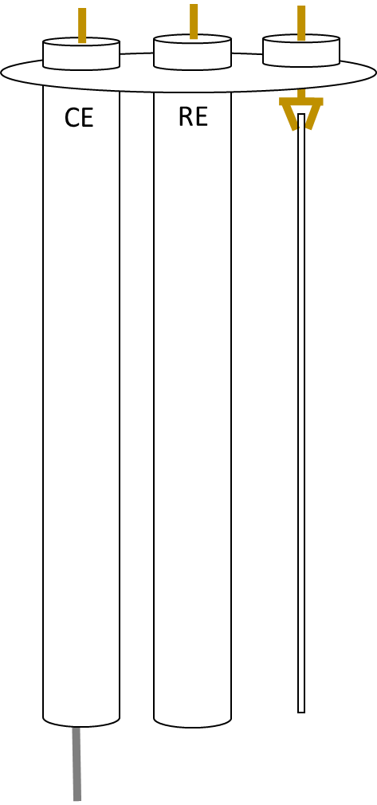
Washing the cell stations
Purpose is to wash prior to each new trial run, as new electrolyte will be used for each run
1. Bath Wash
Fill separate vial with water and place onto lid set-up
Will require subsequent washing steps, likely some solvent change, possibly
some motion (rotation?) to help “stir” solution?
A simple dip may be sufficient enough…checking experimentally
2. Spray Wash
Use a nozzle to lightly spray the electrolyte off of the 3 electrodes
Should be gentle “running” over the electrodes
Can build into the lid?
Spray nozzle
built into lid?
Spray nozzle
on side?

Slide 15
EChem Module – Input/Output – Deposition Cell
Inputs (Software):
Potentiostat
Electrochemical Profile
Programmed current/voltage profile
Inputs (Physical):
Glass Slide
Deposition Solution
Outputs (Physical):
Glass slide w/ catalyst deposition

Slide 16
EChem Module – Input/Output – Characterization Cell
Inputs (Software):
Potentiostat
Electrochemical Profile
Programmed current/voltage profile
Inputs (Physical):
Coated Glass Slide
Characterization Solution
Outputs (Software):
Potentiostat
Electrochemical
Current/Voltage Response
Performance Descriptors
O₂ Analyzer (Char Cell Only)
O₂ Evolution profile
Camera
Image

Slide 17
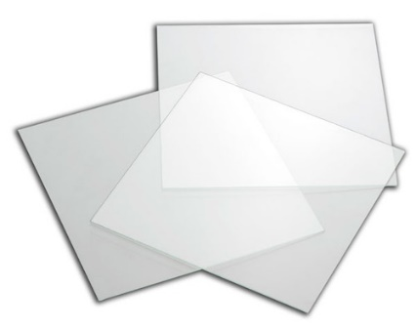
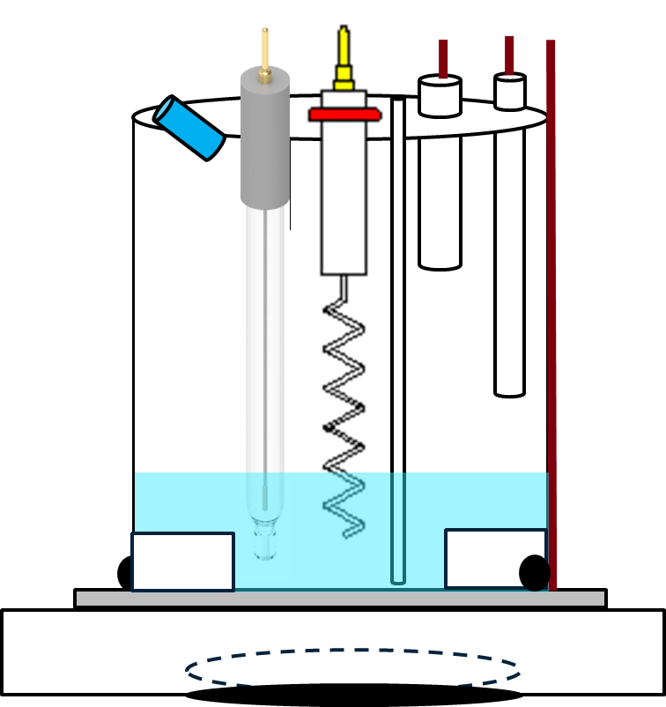
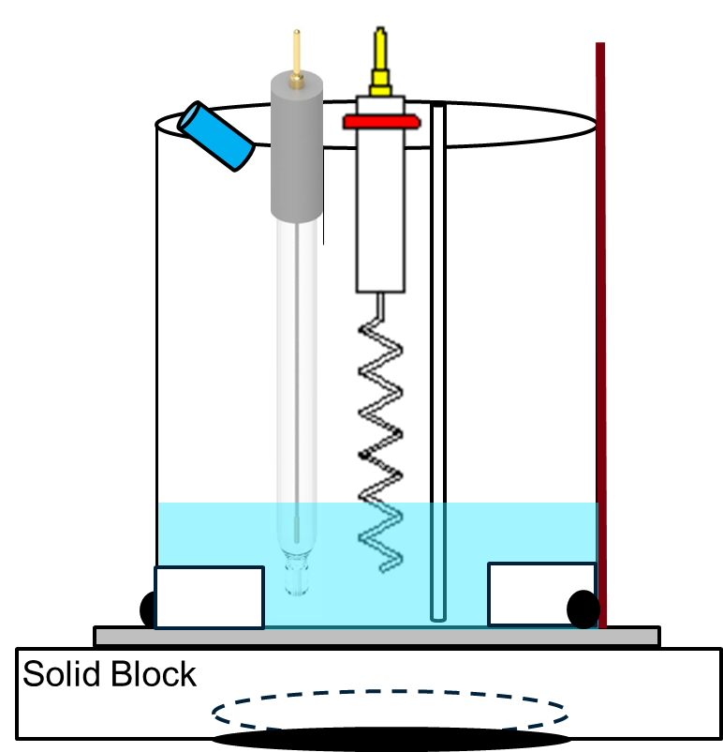
EChem Module – Sizing & Components
Deposition Cell
Area = 1.5 cm²
No O₂ Analyzer
No Agitation
Characterization Cell
Area = 1 cm²
Glass Slide
25 mm x 25 mm x 2.2 mm
>
Cell Body
Accommodate at least 5 mL of electrolyte
Still in development

Slide 18
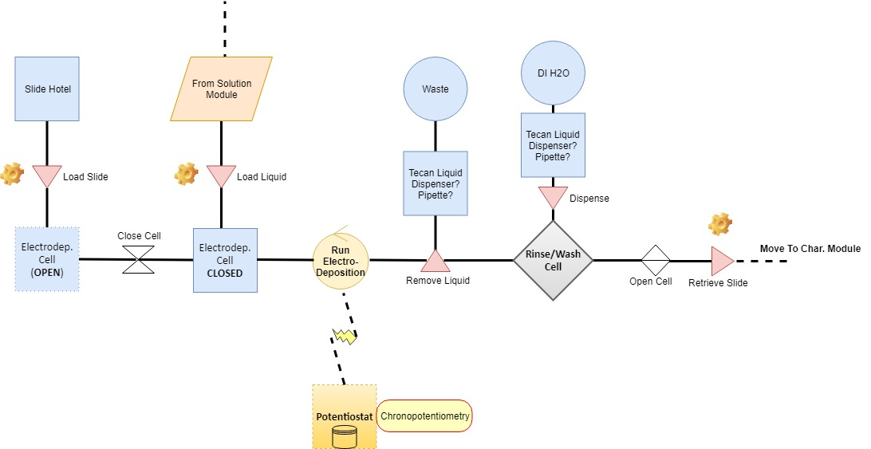
EChem Module Step 1 – ElectroDeposition

Slide 19
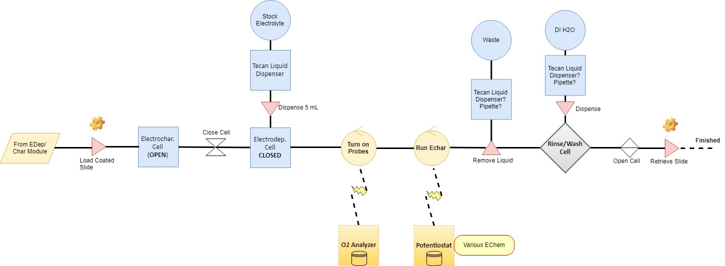
EChem Module Step 2 – ElectroCharacterization

Slide 20
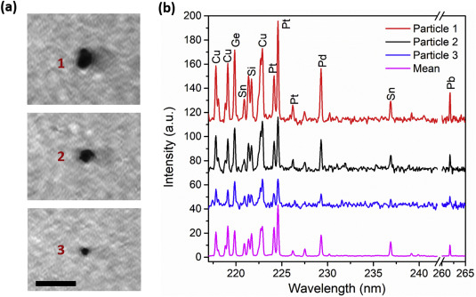
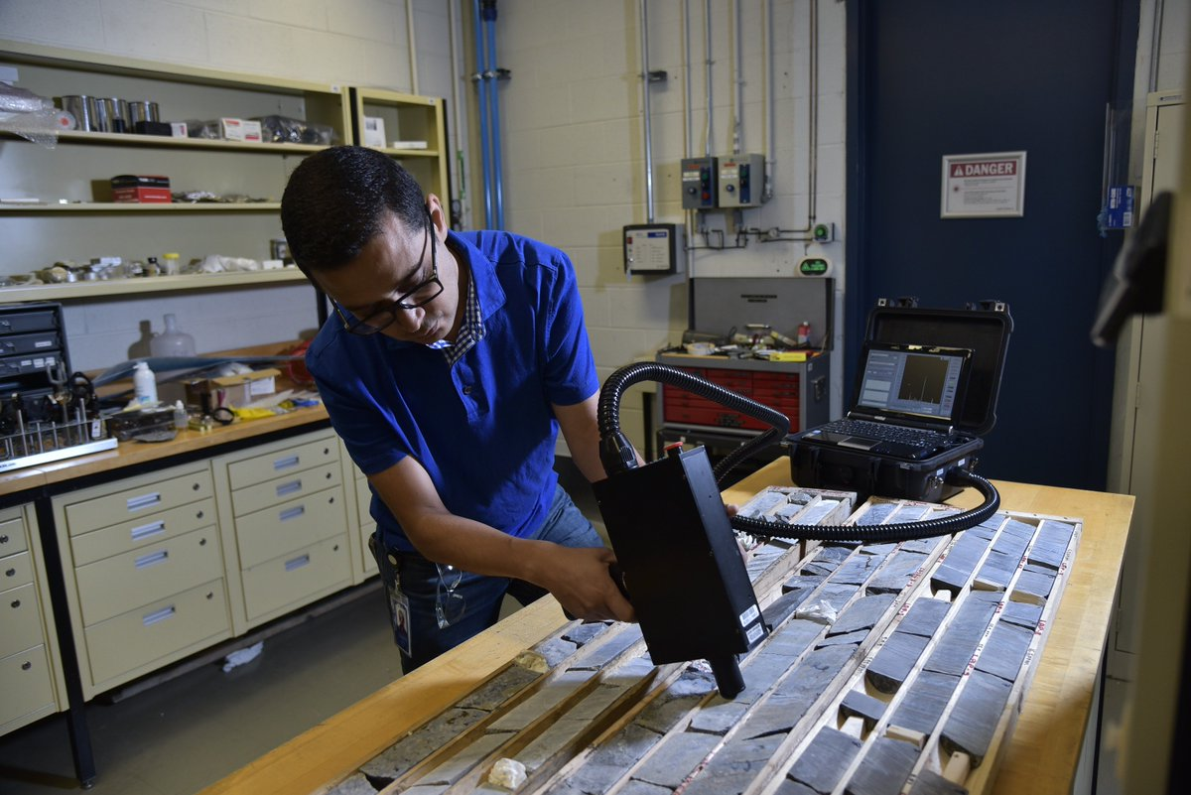
Elemental Characterization – Characterization Module
Laser Induced Breakdown Spectroscopy (LIBS)
High throughput elemental characterization technique used widely in the mining, thin film, and precious metal industry
NRC hosts world leading researcher in this technique (Dr. Mohamad Sabsabi) to design and provide custom polyvalent system
Custom designed to be utilized in-line with MAPs platform
Zhang et. al. 1095, 25, , p. 14-19, 2020.

Slide 21
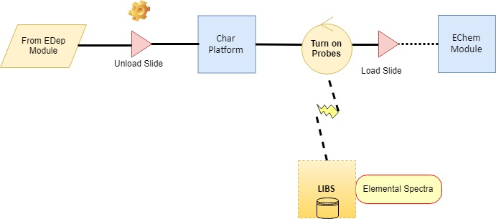
Elemental Characterization Step
LIBS Front End
Glass Slide

Slide 22
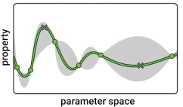
Throughput
Typical Experimental Throughput – Assume Single Cell
1. Initial guess of composition
2. Solution mixing – 2 minutes
3. Electrodeposition – 5 minutes maximum
4. Electrochemical characterization – 5 minutes (+)
5. Elemental Analysis – 5-10 seconds
6. A.I - Data (elemental concentration, potential, current) feed into ChemOS, next target is given
– 5 minutes
Macleod et. al. arXiv: 1906.05398
Total ~15 minutes per run

Slide 23
Development Road Map – Solution Module
Confirm workflow and specifications
Simulate workflow of components?
(when?) Begin construction of solution module at NRCan
Further inventory integration

Slide 24
Development Road Map – EChem Module
Physical Platform
Confirm input/output for platform (various probes etc.)
Model cell design + actuator system (Co-op student?)
Simulate integration into platform
Physical construction of Echem Module
Physical Integration into platform
Instrument Integration
Python wrapper for Biologic SP-150 (VSP-300) (critical!)
O₂ sensor integration (Neofox) – Arduino RS-232 Communication (+ others)
Camera module
Software
Workflow and Operations (all equipment)

Slide 25
Development Road Map – Characterization Module
Physical Platform
Design of loading platform for LIBS probe
Workflow for platform loading
Software
How to proceed with in-house developed integration?
Integration onto platform

Slide 26
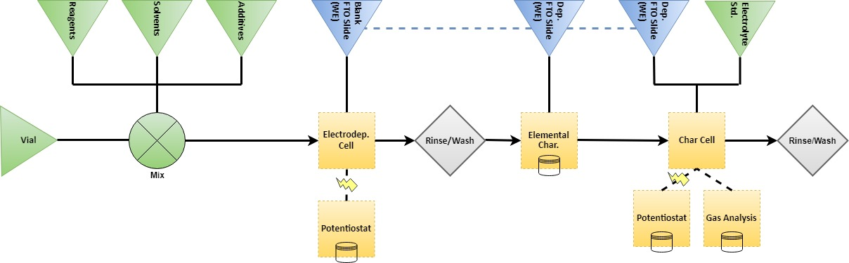
(Condensed) Example Work Flow
Transfer
Addition
Char Module
Solution Module
EChem module
EChem module

Slide 27
Project Timeline
Physical Platform
Initial Construction (Solution Platform) – May 2020
Echem Module Design and Development – May 2020 – Sept. 2020
Initial Automated Capabilities & Further Platform Development – Oct. 2020 – June 2021
Iterative Design, Expansions, and Coupling to AI & Database – Oct. 2020 – Jan 2022
Machine Learning/AI
Parallel Project under MCF Challenge Program – May 2020 – Apr. 2022
Database & Network Evaluation
Collaborative Project involving other MCF projects, KITs, and NRCan Collaborators – Start May 2020

Slide 28
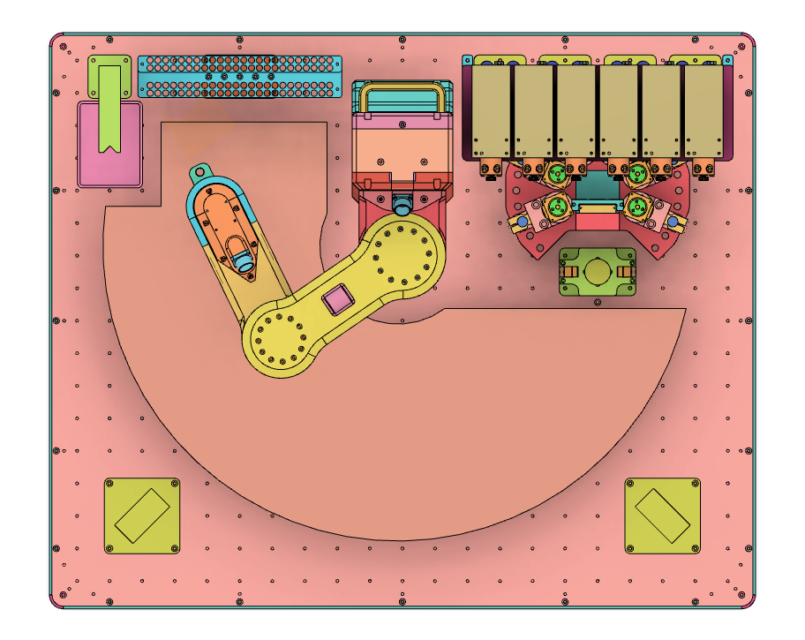
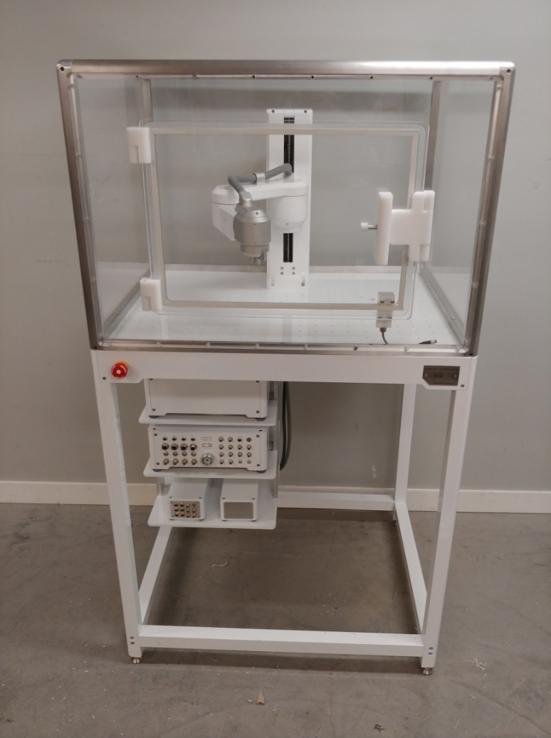
Concept Images

Slide 29
Extra Slides

Slide 30
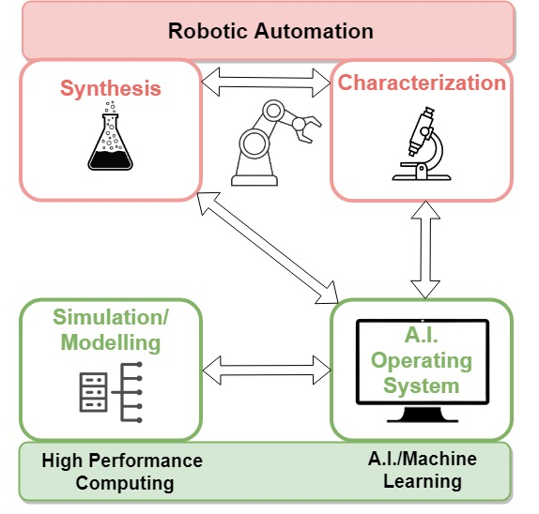
R&D Focus – NRC Mississauga
Core Competencies
High Throughput & Closed loop Synthesis (Intelligent Throughput) and Characterization Tools
Computational Material Discovery (Simulation & AI)
Optimization/Performance prediction
Self-Driving Laboratory
Materials and Process Database
Collaborative & AI/ML accessible
Integrate other data from outside sources
MAPs at NRC-M
Engage with other RCs and collaborators to establish
MAPs for accelerated materials discovery in targeted
domains (material or process) of RCs at NRC-M
Database
Notes:
High-throughput experimentation (HTE) (Leader)
NRC-M will collaboratively engage with other RCs and external partners in the design, development, and integration of HTE towards the development of MAPs (robotic, rapid and automated). This also involves development of methods to “scale” representative manufacturing processes for integration into MAPs.
Computational (AI-driven) materials discovery, design and process simulation (Leader / Collaborator)
This competency will involve establishment and deployment of artificial intelligence / machine learning (AI/ML) and modeling tools that accelerate materials discovery, process scale-up and optimization and predict performance and durability. It will aim to address all critical factors for successful materials transition to implementation (e.g. structure, properties, performance, durability, economics, manufacturability, environmental impacts, health impacts, etc.). This capability is critical to achieve self-driving laboratories and HTE.
Materials and processes databases (Leader / Collaborator)
Curated, national collaborative databases of materials and properties with the information and data obtained from MAPs will be established as the main repository for MAPs-acquired data and information, and to provide critical access to data for AI/ML applications. NRC-M will develop mechanisms to augment MAP-generated data by integrating other experimental and computational data sources from NRC, partners and publicly available sources.
Ultimately, with the help of our collaborators and partners, this is where we want to get to in the long term. Our goal is not to have our very own MAPs, but use this facility to support collaborate MAP opportunities.

Slide 31
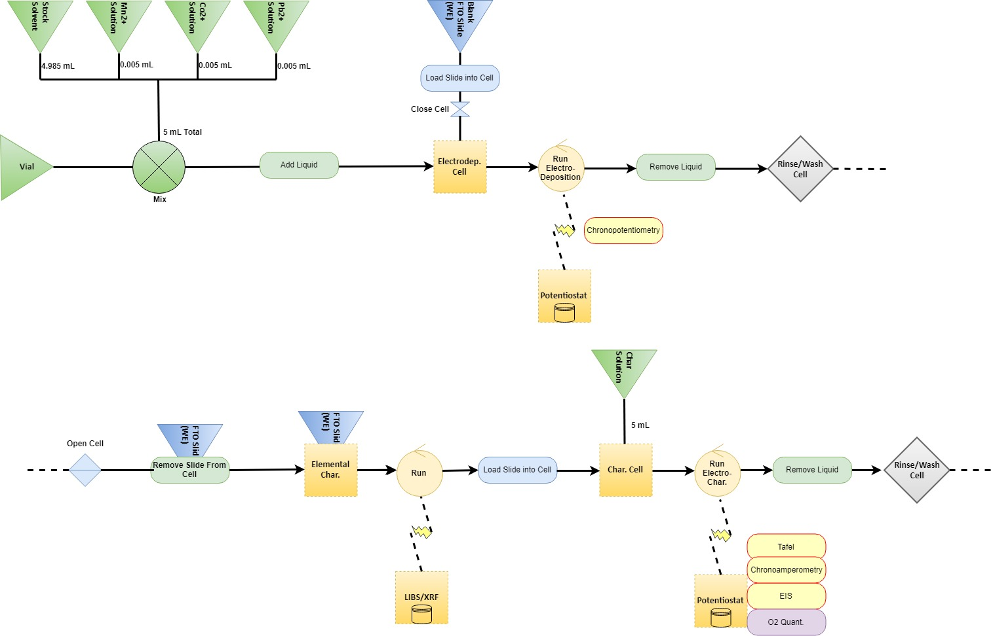
Example Detailed Work Flow: CoMnFeO_{x} (Co:Mn:Fe = 1)
*premade 500 mM concentrations liquid
From slide deck
* 0.5 mM total metal concentration

Slide 32
Example Detailed Work Flow: CoMnFeO_{x} (Co:Mn:Fe = 1)
Stock solution, will never change

Slide 33
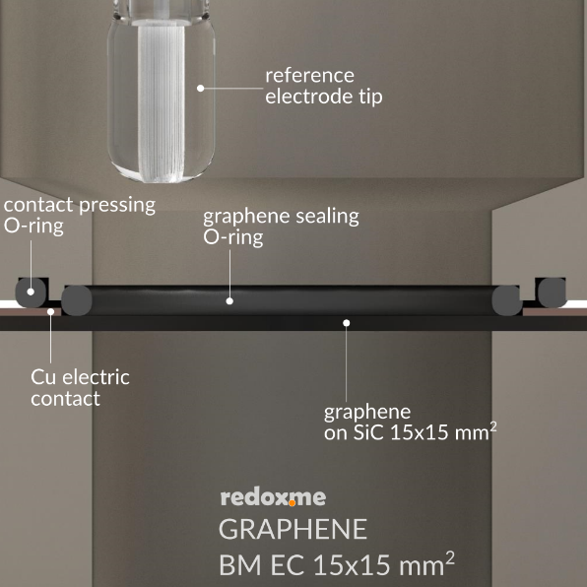
Cell Design
Based on the redox.me bottom-loaded cell, this type of cell may offer more flexibility while also being able to more easily incorporate robotics/automation compared to previous cell design
- Reconstructed to fit a smaller design space, less electrolyte volume
Double o-ring system
allows for electrical
contact to the WE
while also sealing the
liquid
Station will function with an actuator to lift the contents
on and off the working electrode
Pros
+ Easier loading/unloading of working electrode
+ Easier to incorporate dual compartment for future designs
+ All probes loaded “on-board” the automated head
Cons
Electrolyte removal + washing – manageable, but will have to have methods of loading/unloading electrolyte and washing
contents after each measurement

Slide 34
Washing the cell stations
Purpose is to wash prior to each new trial run, as new electrolyte will be used for each run
1. Bath Wash
Fill separate vial with water and place onto lid set-up
Will require subsequent washing steps, likely some solvent change, possibly
some motion (rotation?) to help “stir” solution?
A simple dip may be sufficient enough…checking experimentally
2. Spray Wash
Use a nozzle to lightly spray the electrolyte off of the 3 electrodes
Should be gentle “running” over the electrodes
Can build into the lid?
Spray nozzle
built into lid?
Spray nozzle
on side?

Slide 35
Cell Electrolyte Filling
2. Small tube to add/remove liquid
Robot arm pipettes electrolyte through the top
Problem – How to remove?
3. Something on the bottom/sides?
Electrolyte will have to be added and removed for:
New salt concentrations for the electrodeposition
*maybe* to remove the wash liquid, dependent on the washing procedure
When the actuator removes the base from the lid and the glass slide is to be removed

